Slide 1


Process
Nazneen Akhter ​
Assistant Professor​
Dept. of ICT​
Faculty of Science and Technology​
Bangladesh University of Professionals (BUP) ​
​
​
​
​

Slide 2
Introduction
A process is basically a program in execution
The execution of a process must progress in a sequential fashion
The difference between a process and a program is that a program is a group of instructions whereas the process is the activity
A program is passive; a process is active

Slide 3
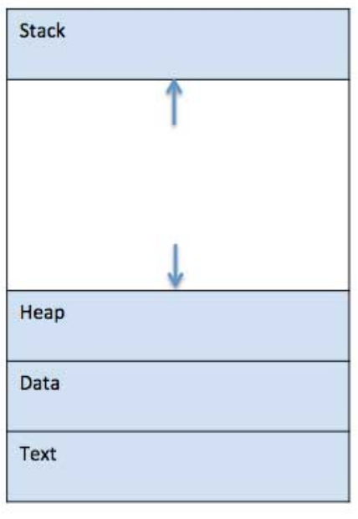
Introduction (Cont.)
When a program is loaded into the memory and it becomes a process, it can be divided into four sections ─
  Stack
  Heap
  Text
  Data

Slide 4
Introduction (Cont.)
S.N. | Component & Description
Stack | Stack contains the temporary data such as method/function parameters, return address and local variables
Heap | This is dynamically allocated memory to a process during its run time
Text | This Section comprises the compiled program code, read in from non-volatile storage when the program is launched
Data | This section contains the global and static variables

Slide 5
Process Life Cycle
Start/ New This is the initial state when a process is first started/ created
Ready The process is waiting to be assigned to a processor. Ready processes are waiting to have the processor allocated to them by the operating system so that they can run. Process may come into this state after Start state or while running it by but interrupted by the scheduler to assign CPU to some other process
Running Once the process has been assigned to a processor by the OS scheduler, the process state is set to running and the processor executes its instructions

Slide 6
Process Life Cycle (Cont.)
Waiting Process moves into the waiting state if it needs to wait for a resource, such as waiting for user input, or waiting for a file to become available
Terminated or Exit Once the process finishes its execution, or it is terminated by the operating system, it is moved to the terminated state where it waits to be removed from main memory

Slide 7
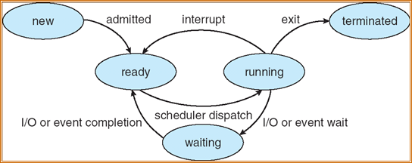
Process Life Cycle (Cont.)
When the scheduler completes its job of selecting a process, it is the dispatcher which takes that process to the desired state/queue

Slide 8
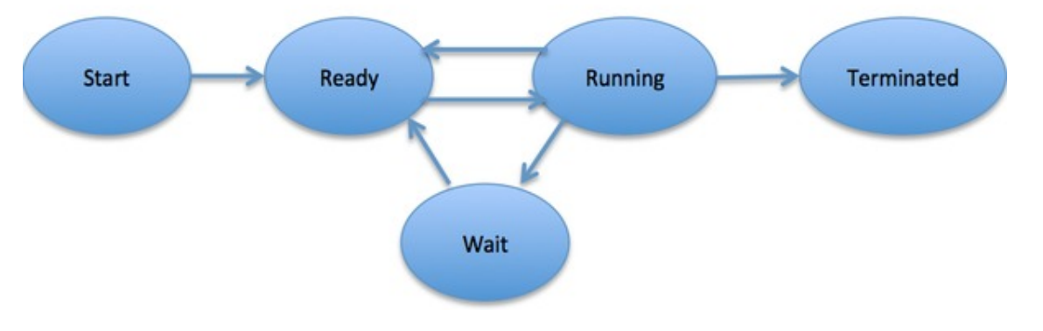
Process Life Cycle (Cont.)

Slide 9

Process Control Block (PCB)
Information associated with each process
(also called task control block)
Process state – running, waiting, etc
Program counter – location of instruction to next execute
CPU registers – contents of all process-centric registers
CPU scheduling information- priorities, scheduling queue pointers
Memory-management information – memory allocated to the process
Accounting information – CPU used, clock time elapsed since start, time limits
I/O status information – I/O devices allocated to process, list of open files

Slide 10
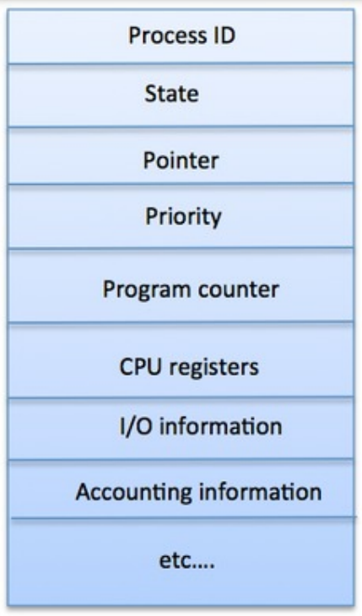
Process Control Block (PCB)

Slide 11
Process Control Block (PCB)
Process State: The current state of the process i.e., whether it is ready, running, waiting, or whatever
Process privileges: This is required to allow/disallow access to system resources
Process ID: Unique identification for each of the process in the operating system
Pointer: A pointer to parent process
Program Counter: Program Counter is a pointer to the address of the next instruction to be executed for this process
CPU registers: Various CPU registers where process need to be stored for execution for running state

Slide 12
Process Control Block (PCB)
CPU Scheduling: Information Process priority and other scheduling information which is required to schedule the process
Memory management information: This includes the information of page table, memory limits, Segment table depending on memory used by the operating system
Accounting information: This includes the amount of CPU used for process execution, time limits, execution ID etc.
I/O status information: This includes a list of I/O devices allocated to the process

Slide 13
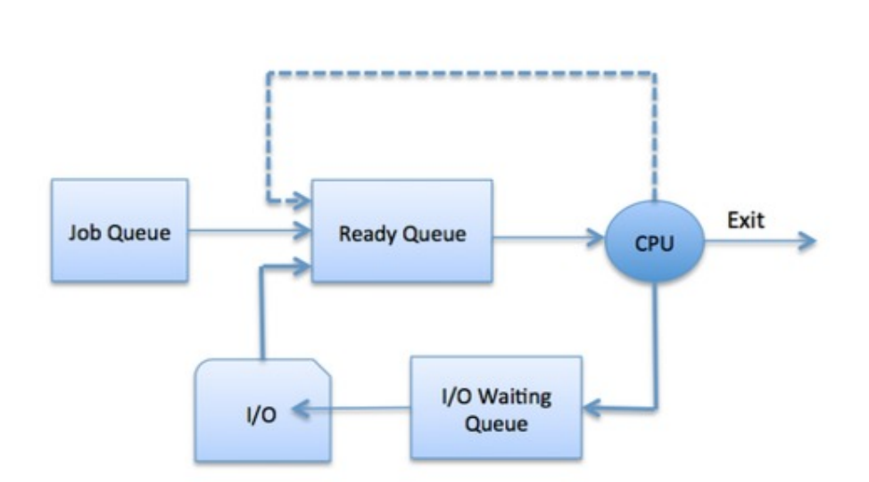
Process Scheduling
The process scheduling is the activity of the process manager that handles the removal of the running process from the CPU and the selection of another process on the basis of a particular strategy
The Operating System maintains the following important process scheduling queues
  Job queue
  Ready queue
  Device queues

Slide 14
Schedulers
The main task of schedulers is to select the jobs to be submitted into the system and to decide which process to run
Schedulers are of three types
    • Long-Term Scheduler
    • Short-Term Scheduler
    • Medium-Term Schedule

Slide 15
Long Term Scheduler
It is also called a job scheduler
A long-term scheduler determines which programs are admitted to the system for processing
It selects processes from the queue and loads them into memory for execution
Process loads into the memory for CPU scheduling. The primary objective of the job scheduler is to provide a balanced mix of jobs, such as I/O bound, and processor bound
It also controls the degree of multiprogramming
If the degree of multiprogramming is stable, then the average rate of process creation must be equal to the average departure rate of processes leaving the system
On some systems, the long-term scheduler may not be available or minimal
Time-sharing operating systems have no long-term scheduler. When a process changes the state from new to ready, then there is use of long-term scheduler

Slide 16
Long Term Scheduler (Cont..)
Long-term scheduler (or job scheduler) – selects which processes should be brought into the ready queue
  Long-term scheduler is invoked infrequently (seconds, minutes) ⇒ (may be slow)
  The long-term scheduler controls the degree of multiprogramming
Processes can be described as either:
  I/O-bound process – spends more time doing I/O than computations, many short CPU bursts
  CPU-bound process – spends more time doing computations; few very long CPU bursts

Slide 17
Short Term Scheduler
It is also called as CPU scheduler
Its main objective is to increase system performance in accordance with the chosen set of criteria
It is the change of ready state to running state of the process
CPU scheduler selects a process among the processes that are ready to execute and allocates CPU to one of them
Short-term schedulers, also known as dispatchers, make the decision of which process to execute next
Short-term schedulers are faster than long-term schedulers

Slide 18
Short Term Scheduler (Cont..)
Short-term scheduler (or CPU scheduler) – selects which process should be executed next and allocates CPU
Sometimes the only scheduler in a system
  Short-term scheduler is invoked frequently (milliseconds) ⇒ (must be fast)

Slide 19
Medium Term Scheduler
Medium-term scheduling is a part of swapping
It removes the processes from the memory
It reduces the degree of multiprogramming
The medium-term scheduler is in-charge of handling the swapped out-processes
A running process may become suspended if it makes an I/O request
A suspended processes cannot make any progress towards completion
In this condition, to remove the process from memory and make space for other processes, the suspended process is moved to the secondary storage. This process is called swapping, and the process is said to be swapped out or rolled out
Swapping may be necessary to improve the process mix

Slide 20
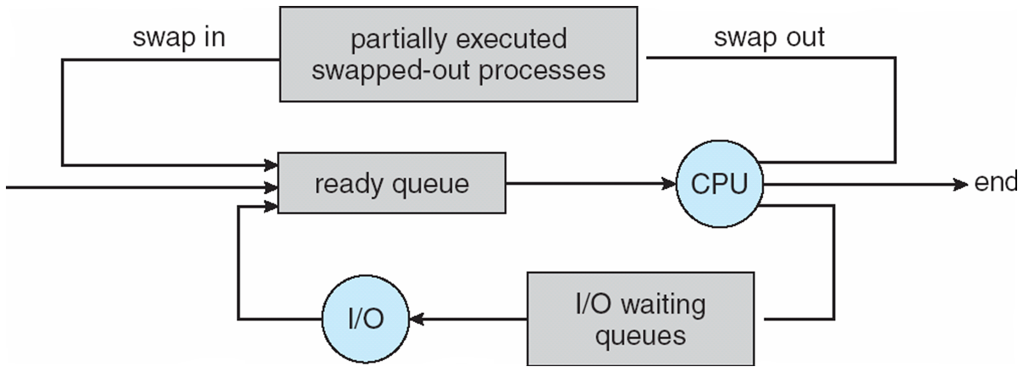
Medium-term scheduler (Cont..)
Medium-term scheduler can be added if degree of multiple programming needs to decrease
  Remove process from memory, store on disk, bring back in from disk to continue execution: swapping

Slide 21
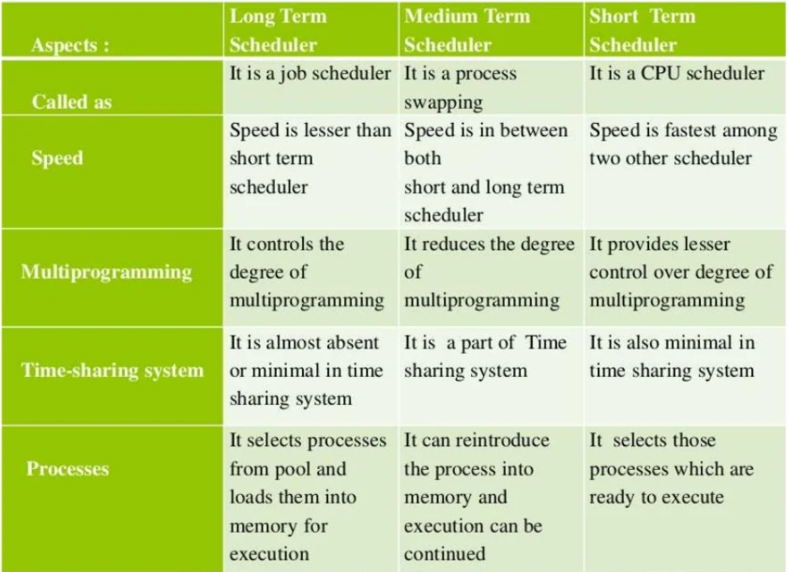
Differences

Slide 22
Context Switching
It is a technique or method used by the operating system to switch a process from one state to another to execute its function using CPUs in the system
Context Switching involves storing the context or state of a process so that it can be reloaded when required and execution can be resumed from the same point as earlier
This is a feature of a multitasking operating system and allows a single CPU to be shared by multiple processes
Let, initially Process 1 is running. Process 1 is switched out and Process 2 is switched in because of an interrupt or a system call. Context switching involves saving the state of Process 1 into PCB1 and loading the state of process 2 from PCB2. After some time again a context switch occurs and Process 2 is switched out and Process 1 is switched in again. This involves saving the state of Process 2 into PCB2 and loading the state of process 1 from PCB1

Slide 23
Context Switching Triggers
There are three major triggers for context switching. These are given as follows−
Multitasking: In a multitasking environment, a process is switched out of the CPU so another process can be run. The state of the old process is saved and the state of the new process is loaded. On a pre-emptive system, processes may be switched out by the scheduler
Interrupt Handling: The hardware switches a part of the context when an interrupt occurs. This happens automatically. Only some of the context is changed to minimize the time required to handle the interrupt
User and Kernel Mode Switching: A context switch may take place when a transition between the user mode and kernel mode is required in the operating system

Slide 24
Context Switching Steps
The steps involved in context switching are as follows −
Save the context of the process that is currently running on the CPU. Update the process control block and other important fields
Move the process control block of the above process into the relevant queue such as the ready queue, I/O queue etc.
Select a new process for execution
Update the process control block of the selected process. This includes updating the process state to running
Update the memory management data structures as required
Restore the context of the process that was previously running when it is loaded again on the processor. This is done by loading the previous values of the process control block and registers

Slide 25
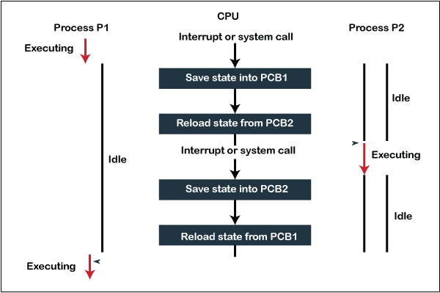
Steps for Context Switching

Slide 26
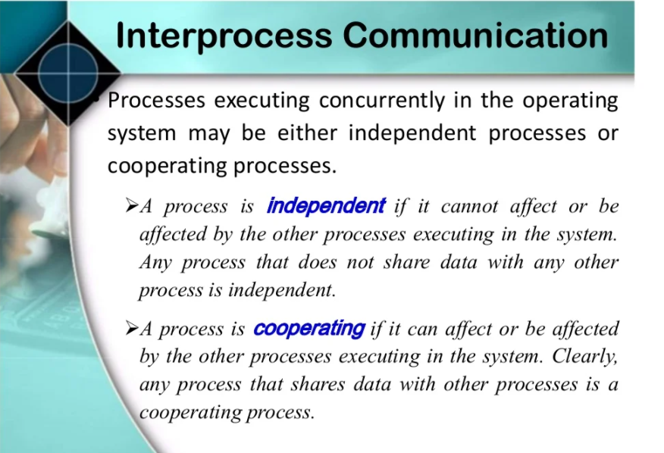

Slide 27
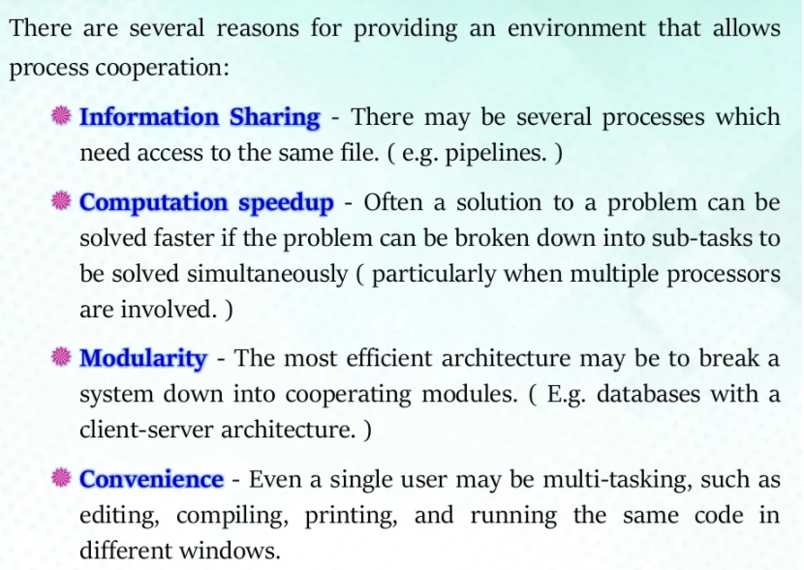

Slide 28
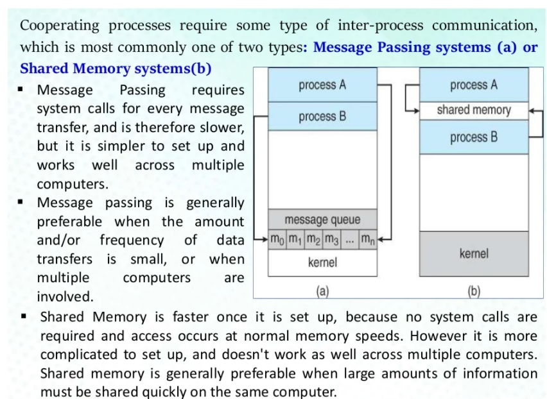

Slide 29
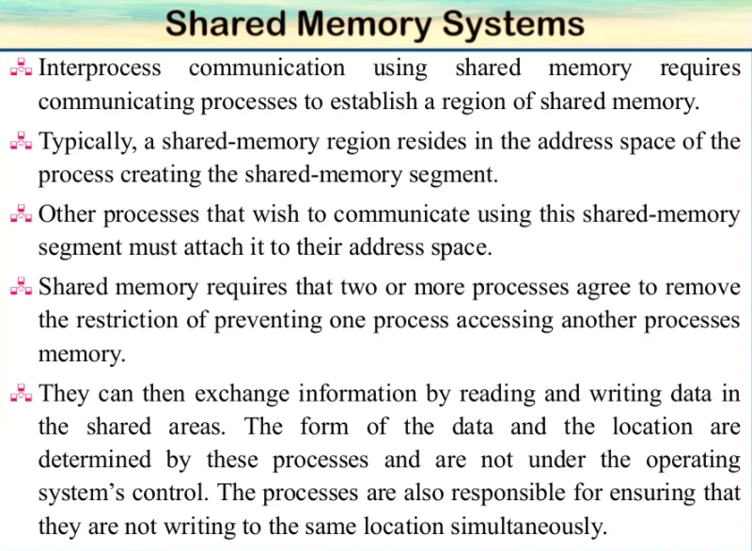

Slide 30
Thank You

